Slide 1
Lecture 14: Joins!
Lecture 14

Slide 2
Announcements: Two Hints
Lecture 14
You may want to do Trigger activity for project 2.
We’ve noticed those who do it have less trouble with project!
Seems like we’re good here ☺ Exciting for us!
We posted an activity for you to do on your own… it may overlap heavily with a ps #3 problem... (this is not necessary but helpful).
The solutions will not be posted.
Sorry the Google lecture was not recorded! Last minute thing...

Slide 3
1. Nested Loop Joins
Lecture 14 > Section 2

Slide 4
What you will learn about in this section
Lecture 14 > Section 2
RECAP: Joins
Nested Loop Join (NLJ)
Block Nested Loop Join (BNLJ)
Index Nested Loop Join (INLJ)

Slide 5
RECAP: Joins
Lecture 14 > Section 2 > Joins

Slide 6
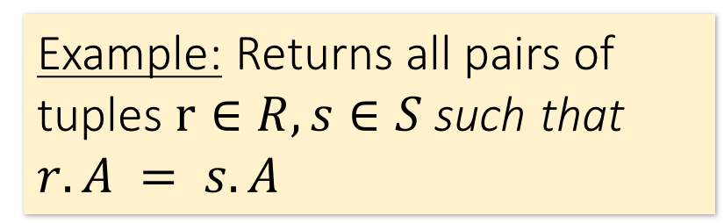
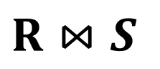
Joins: Example
Lecture 14 > Section 2 > Joins
$R⋈S$
SELECT R.A,B,C,D FROM R, S
WHERE R.A = S.A
Example: Returns all pairs of tuples $r∈R, s∈S$such that $r.A = s.A$
R
S
A | B | C
1 | 0 | 1
2 | 3 | 4
2 | 5 | 2
3 | 1 | 1
A | D
3 | 7
2 | 2
2 | 3
A | B | C | D
2 | 3 | 4 | 2

Slide 7
Joins: Example
Lecture 14 > Section 2 > Joins
$R⋈S$
SELECT R.A,B,C,D FROM R, S
WHERE R.A = S.A
Example: Returns all pairs of tuples $r∈R, s∈S$such that $r.A = s.A$
R
S
A | B | C
1 | 0 | 1
2 | 3 | 4
2 | 5 | 2
3 | 1 | 1
A | D
3 | 7
2 | 2
2 | 3
A | B | C | D
2 | 3 | 4 | 2
2 | 3 | 4 | 3

Slide 8
Joins: Example
Lecture 14 > Section 2 > Joins
$R⋈S$
SELECT R.A,B,C,D FROM R, S
WHERE R.A = S.A
Example: Returns all pairs of tuples $r∈R, s∈S$such that $r.A = s.A$
R
S
A | B | C
1 | 0 | 1
2 | 3 | 4
2 | 5 | 2
3 | 1 | 1
A | D
3 | 7
2 | 2
2 | 3
A | B | C | D
2 | 3 | 4 | 2
2 | 3 | 4 | 3
2 | 5 | 2 | 2

Slide 9
Joins: Example
Lecture 14 > Section 2 > Joins
$R⋈S$
SELECT R.A,B,C,D FROM R, S
WHERE R.A = S.A
Example: Returns all pairs of tuples $r∈R, s∈S$such that $r.A = s.A$
R
S
A | B | C
1 | 0 | 1
2 | 3 | 4
2 | 5 | 2
3 | 1 | 1
A | D
3 | 7
2 | 2
2 | 3
A | B | C | D
2 | 3 | 4 | 2
2 | 3 | 4 | 3
2 | 5 | 2 | 2
2 | 5 | 2 | 3

Slide 10
Joins: Example
Lecture 14 > Section 2 > Joins
$R⋈S$
SELECT R.A,B,C,D FROM R, S
WHERE R.A = S.A
Example: Returns all pairs of tuples $r∈R, s∈S$such that $r.A = s.A$
R
S
A | B | C
1 | 0 | 1
2 | 3 | 4
2 | 5 | 2
3 | 1 | 1
A | D
3 | 7
2 | 2
2 | 3
A | B | C | D
2 | 3 | 4 | 2
2 | 3 | 4 | 3
2 | 5 | 2 | 2
2 | 5 | 2 | 3
3 | 1 | 1 | 7

Slide 11

Semantically: A Subset of the Cross Product
Lecture 14 > Section 2 > Joins
$R⋈S$
SELECT R.A,B,C,D FROM R, S
WHERE R.A = S.A
Example: Returns all pairs of tuples $r∈R, s∈S$such that $r.A = s.A$
R
S
A | B | C | D
2 | 3 | 4 | 2
2 | 3 | 4 | 3
2 | 5 | 2 | 2
2 | 5 | 2 | 3
3 | 1 | 1 | 7
A | B | C
1 | 0 | 1
2 | 3 | 4
2 | 5 | 2
3 | 1 | 1
A | D
3 | 7
2 | 2
2 | 3
…
$$×$$
Can we actually implement a join in this way?
Cross Product
Filter by conditions
(r.A = s.A)

Slide 12
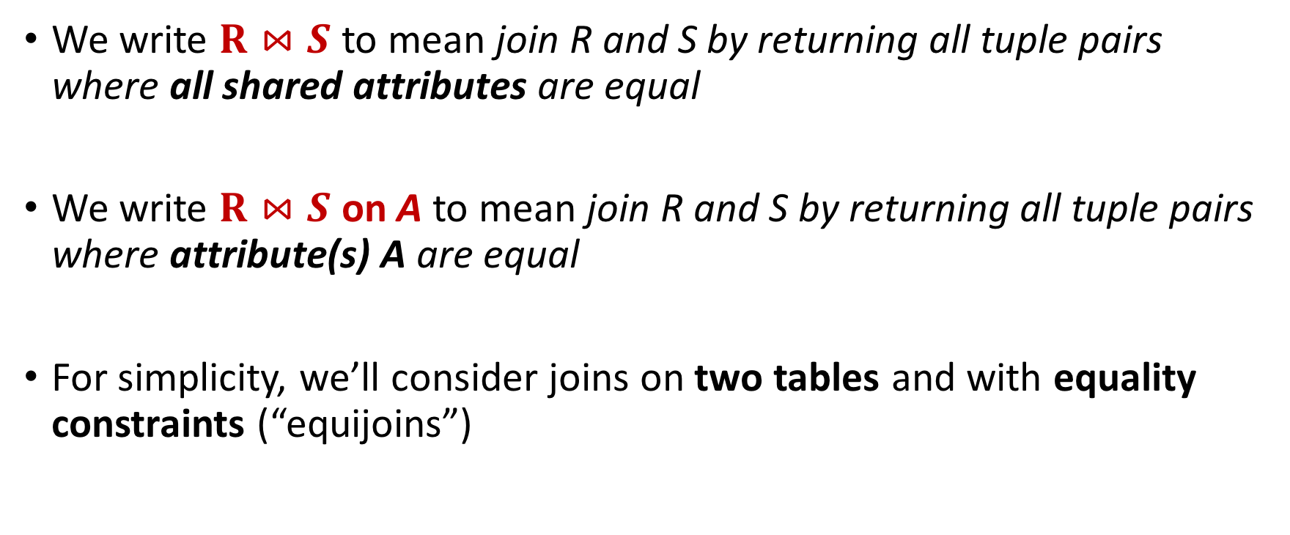
Notes
Lecture 14 > Section 2 > Joins
We write $R⋈S$ to mean join R and S by returning all tuple pairs where all shared attributes are equal
We write $R⋈S$ on A to mean join R and S by returning all tuple pairs where attribute(s) A are equal
For simplicity, we’ll consider joins on two tables and with equality constraints (“equijoins”)
However joins can merge > 2 tables, and some algorithms do support non-equality constraints!

Slide 13
Nested Loop Joins
Lecture 14 > Section 2 > NLJ

Slide 14
Notes
Lecture 14 > Section 2 > NLJ
We are again considering “IO aware” algorithms: care about disk IO
Given a relation R, let:
T(R) = # of tuples in R
P(R) = # of pages in R
Note also that we omit ceilings in calculations… good exercise to put back in!
Recall that we read / write entire pages with disk IO

Slide 15
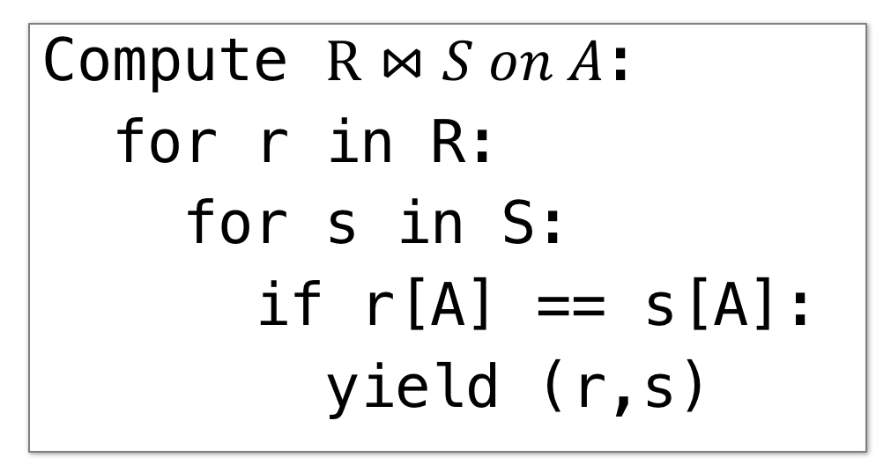
Nested Loop Join (NLJ)
Lecture 14 > Section 2 > NLJ
Compute $R⋈S on A$:
for r in R:
for s in S:
if r[A] == s[A]:
yield (r,s)

Slide 16
Nested Loop Join (NLJ)
Lecture 14 > Section 2 > NLJ
Cost:
Compute $R⋈S on A$:
for r in R:
for s in S:
if r[A] == s[A]:
yield (r,s)
P(R)
Loop over the tuples in R
Note that our IO cost is based on the number of pages loaded, not the number of tuples!

Slide 17
Nested Loop Join (NLJ)
Lecture 14 > Section 2 > NLJ
Cost:
Compute $R⋈S on A$:
for r in R:
for s in S:
if r[A] == s[A]:
yield (r,s)
P(R) + T(R)*P(S)
Loop over the tuples in R
For every tuple in R, loop over all the tuples in S
Have to read all of S from disk for every tuple in R!

Slide 18
Nested Loop Join (NLJ)
Lecture 14 > Section 2 > NLJ
Cost:
Compute $R⋈S on A$:
for r in R:
for s in S:
if r[A] == s[A]:
yield (r,s)
P(R) + T(R)*P(S)
Loop over the tuples in R
For every tuple in R, loop over all the tuples in S
Check against join conditions
Note that NLJ can handle things other than equality constraints… just check in the if statement!

Slide 19
Nested Loop Join (NLJ)
Lecture 14 > Section 2 > NLJ
Cost:
Compute $R⋈S on A$:
for r in R:
for s in S:
if r[A] == s[A]:
yield (r,s)
P(R) + T(R)*P(S) + OUT
Loop over the tuples in R
For every tuple in R, loop over all the tuples in S
Check against join conditions
Write out (to page, then when page full, to disk)
What would OUT be if our join condition is trivial (if TRUE)?
OUT could be bigger than P(R)*P(S)… but usually not that bad

Slide 20
Nested Loop Join (NLJ)
Lecture 14 > Section 2 > NLJ
Cost:
Compute $R⋈S on A$:
for r in R:
for s in S:
if r[A] == s[A]:
yield (r,s)
P(R) + T(R)*P(S) + OUT
What if R (“outer”) and S (“inner”) switched?
P(S) + T(S)*P(R) + OUT
Outer vs. inner selection makes a huge difference- DBMS needs to know which relation is smaller!

Slide 21
IO-Aware Approach
Lecture 14 > Section 2 > BNLJ

Slide 22
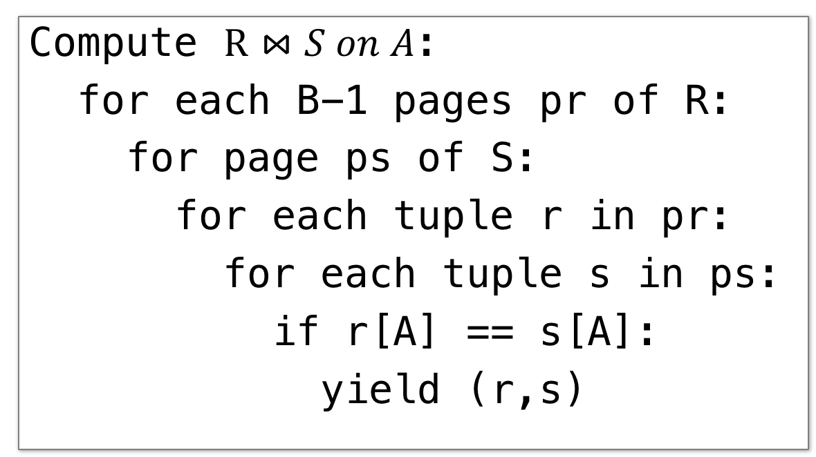
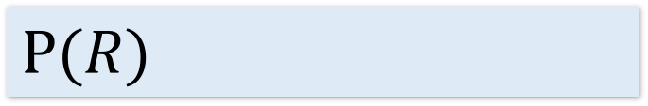
Block Nested Loop Join (BNLJ)
Lecture 14 > Section 2 > BNLJ
Given B+1 pages of memory
Cost:
Compute $R⋈S on A$:
for each B-1 pages pr of R:
for page ps of S:
for each tuple r in pr:
for each tuple s in ps:
if r[A] == s[A]:
yield (r,s)
$$P(R)$$
Load in B-1 pages of R at a time (leaving 1 page each free for S & output)
Note: There could be some speedup here due to the fact that we’re reading in multiple pages sequentially however we’ll ignore this here!

Slide 23
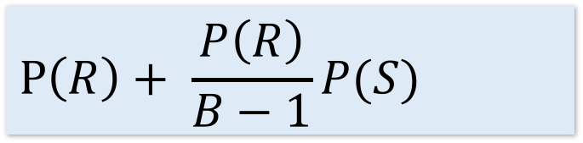
Block Nested Loop Join (BNLJ)
Lecture 14 > Section 2 > BNLJ
Given B+1 pages of memory
Cost:
Compute $R⋈S on A$:
for each B-1 pages pr of R:
for page ps of S:
for each tuple r in pr:
for each tuple s in ps:
if r[A] == s[A]:
yield (r,s)
$$P\left(R\right)+ \frac{P\left(R\right)}{B−1}P(S)$$
Load in B-1 pages of R at a time (leaving 1 page each free for S & output)
For each (B-1)-page segment of R, load each page of S
Note: Faster to iterate over the smaller relation first!

Slide 24
Block Nested Loop Join (BNLJ)
Lecture 14 > Section 2 > BNLJ
Given B+1 pages of memory
Cost:
Compute $R⋈S on A$:
for each B-1 pages pr of R:
for page ps of S:
for each tuple r in pr:
for each tuple s in ps:
if r[A] == s[A]:
yield (r,s)
$$P\left(R\right)+ \frac{P\left(R\right)}{B−1}P(S)$$
Load in B-1 pages of R at a time (leaving 1 page each free for S & output)
For each (B-1)-page segment of R, load each page of S
Check against the join conditions
BNLJ can also handle non-equality constraints

Slide 25
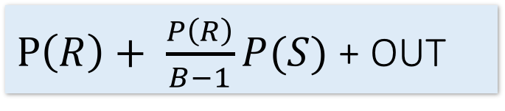
Block Nested Loop Join (BNLJ)
Lecture 14 > Section 2 > BNLJ
Given B+1 pages of memory
Cost:
Compute $R⋈S on A$:
for each B-1 pages pr of R:
for page ps of S:
for each tuple r in pr:
for each tuple s in ps:
if r[A] == s[A]:
yield (r,s)
$P\left(R\right)+ \frac{P\left(R\right)}{B−1}P(S)$ + OUT
Load in B-1 pages of R at a time (leaving 1 page each free for S & output)
For each (B-1)-page segment of R, load each page of S
Check against the join conditions
Write out
Again, OUT could be bigger than P(R)*P(S)… but usually not that bad

Slide 26
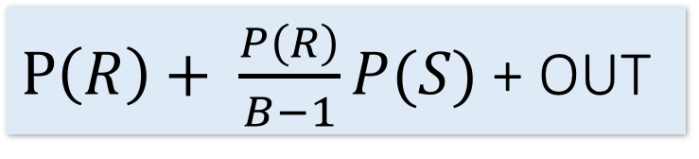
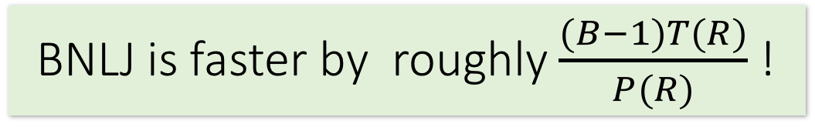
BNLJ vs. NLJ: Benefits of IO Aware
Lecture 14 > Section 2 > BNLJ
In BNLJ, by loading larger chunks of R, we minimize the number of full disk reads of S
We only read all of S from disk for every (B-1)-page segment of R!
Still the full cross-product, but more done only in memory
NLJ
BNLJ
P(R) + T(R)*P(S) + OUT
$P\left(R\right)+ \frac{P\left(R\right)}{B−1}P(S)$ + OUT
BNLJ is faster by roughly $\frac{(B−1)T(R)}{P(R)}$ !

Slide 27
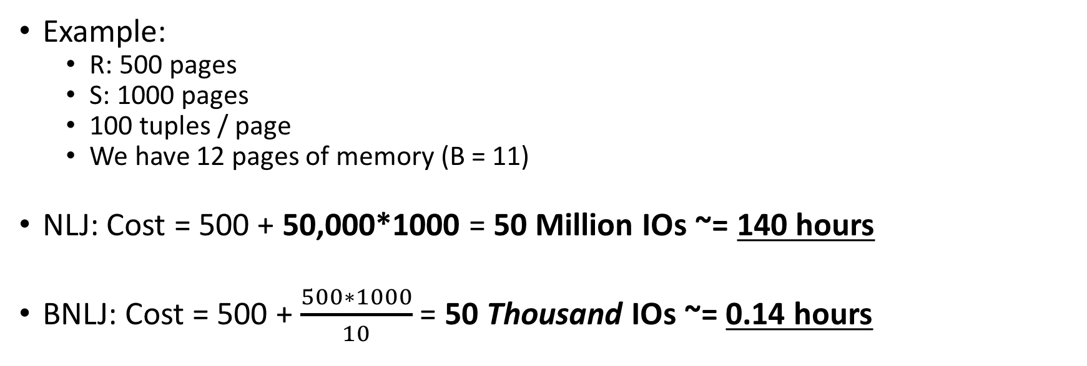
BNLJ vs. NLJ: Benefits of IO Aware
Lecture 14 > Section 2 > BNLJ
Example:
R: 500 pages
S: 1000 pages
100 tuples / page
We have 12 pages of memory (B = 11)
NLJ: Cost = 500 + 50,000*1000 = 50 Million IOs ~= 140 hours
BNLJ: Cost = 500 + $\frac{500∗1000}{10}$ = 50 Thousand IOs ~= 0.14 hours
Ignoring OUT here…
A very real difference from a small change in the algorithm!

Slide 28
Smarter than Cross-Products
Lecture 14 > Section 2 > INLJ

Slide 29
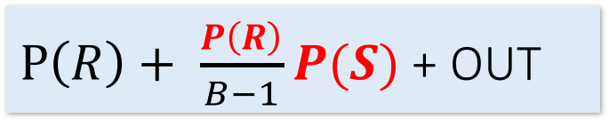
Smarter than Cross-Products: From Quadratic to Nearly Linear
Lecture 14 > Section 2 > INLJ
All joins that compute the full cross-product have some quadratic term
For example we saw:
Now we’ll see some (nearly) linear joins:
~ O(P(R) + P(S) + OUT), where again OUT could be quadratic but is usually better
NLJ
P(R) + T(R)P(S) + OUT
$P\left(R\right)+ \frac{P\left(R\right)}{B−1}P(S)$ + OUT
BNLJ
We get this gain by taking advantage of structure- moving to equality constraints (“equijoin”) only!

Slide 30
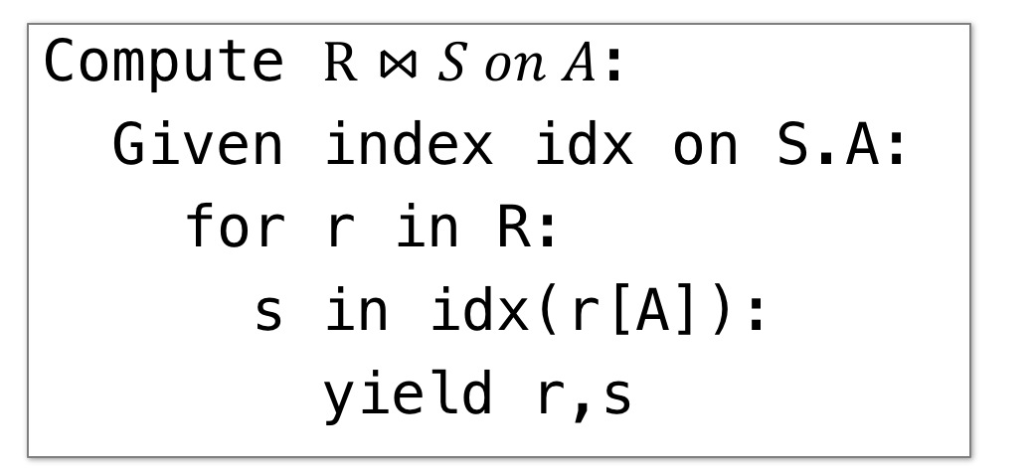
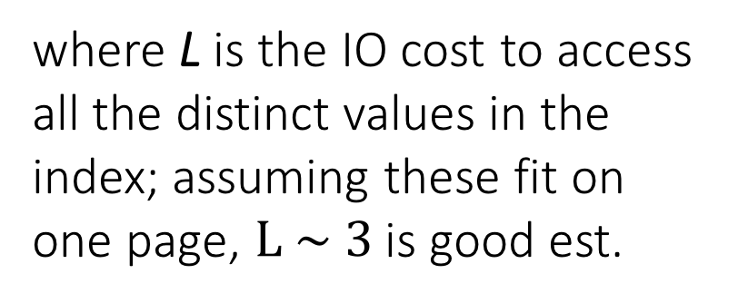
Index Nested Loop Join (INLJ)
Lecture 14 > Section 2 > INLJ
Cost:
Compute $R⋈S on A$:
Given index idx on S.A:
for r in R:
s in idx(r[A]):
yield r,s
P(R) + T(R)*L + OUT
where L is the IO cost to access all the distinct values in the index; assuming these fit on one page, $L \sim 3$ is good est.
→ We can use an index (e.g. B+ Tree) to avoid doing the full cross-product!

Slide 31
Joins: A Cage Match
Lecture 15
Message: It’s all about the memory!

Slide 32
Today’s Lecture
Lecture 15
Sort-Merge Join (SMJ)
Hash Join (HJ)
The Cage Match: SMJ vs. HJ

Slide 33

1. Sort-Merge Join (SMJ)
Lecture 15 > Section 1

Slide 34
What you will learn about in this section
Lecture 15 > Section 1
Sort-Merge Join
“Backup” & Total Cost
Optimizations
ACTIVITY: Sequential Flooding

Slide 35
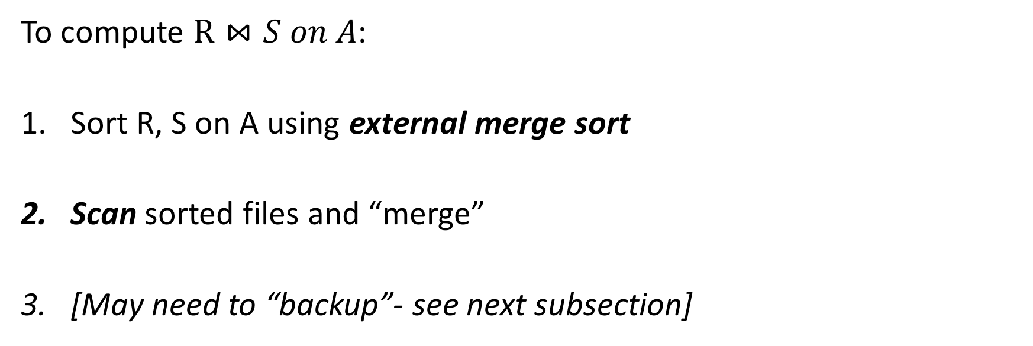
Sort Merge Join (SMJ): Basic Procedure
Lecture 15 > Section 1 > SMJ
To compute $R⋈S on A$:
Sort R, S on A using external merge sort
Scan sorted files and “merge”
[May need to “backup”- see next subsection]
Note that we are only considering equality join conditions here
Note that if R, S are already sorted on A, SMJ will be awesome!

Slide 36

SMJ Example: $R⋈S on A$with 3 page buffer
Lecture 15 > Section 1 > SMJ
For simplicity: Let each page be one tuple, and let the first value be A
We show the file HEAD, which is the next value to be read!
Disk
Main Memory
R
(0,a)
(5,b)
(3,j)
Buffer
S
(3,g)
(7,f)
(0,j)

Slide 37
SMJ Example: $R⋈S on A$with 3 page buffer
Lecture 15 > Section 1 > SMJ
1. Sort the relations R, S on the join key (first value)
Disk
Main Memory
(3,j)
(5,b)
(5,b)
(0,a)
(3,j)
R
(0,a)
Buffer
S
(7,f)
(3,g)
(0,j)
(0,j)
(7,f)
(3,g)

Slide 38
SMJ Example: $R⋈S on A$with 3 page buffer
Lecture 15 > Section 1 > SMJ
2. Scan and “merge” on join key!
Disk
Main Memory
(0,a)
(3,j)
(5,b)
R
(0,a)
Buffer
S
(0,j)
(3,g)
(7,f)
(0,j)
Output

Slide 39
SMJ Example: $R⋈S on A$with 3 page buffer
Lecture 15 > Section 1 > SMJ
2. Scan and “merge” on join key!
Disk
Main Memory
R
(0,a)
(3,j)
(5,b)
Buffer
S
(0,j)
(3,g)
(7,f)
(0,a)
(0,j)
(0,a,j)
Output

Slide 40
SMJ Example: $R⋈S on A$with 3 page buffer
Lecture 15 > Section 1 > SMJ
2. Scan and “merge” on join key!
Disk
Main Memory
(0,a)
(3,j)
(5,b)
R
(3,j)
(5,b)
Buffer
S
(0,j)
(3,g)
(7,f)
(3,g)
(7,f)
(3,j,g)
Output
(0,a,j)

Slide 41
SMJ Example: $R⋈S on A$with 3 page buffer
Lecture 15 > Section 1 > SMJ
2. Done!
Disk
Main Memory
(0,a)
3,j
5,b
R
(3,j)
(5,b)
Buffer
S
(0,j)
3,g
7,f
(3,g)
(7,f)
Output
(0,a,j)
(3,j,g)

Slide 42
What happens with duplicate join keys?
Lecture 15 > Section 1 > Backup

Slide 43
Multiple tuples with Same Join Key: “Backup”
Lecture 15 > Section 1 > Backup
1. Start with sorted relations, and begin scan / merge…
Disk
Main Memory
(0,a)
3,j
5,b
R
(0,a)
(0,j)
(0,b)
Buffer
S
(0,j)
(0,j)
3,g
7,f
(0,g)
(7,f)
Output

Slide 44
Multiple tuples with Same Join Key: “Backup”
Lecture 15 > Section 1 > Backup
1. Start with sorted relations, and begin scan / merge…
Disk
Main Memory
(0,a)
3,j
5,b
R
(0,j)
(0,b)
Buffer
S
(0,j)
3,g
7,f
(0,g)
(7,f)
(0,a)
(0,j)
(0,a,j)
Output

Slide 45
Multiple tuples with Same Join Key: “Backup”
Lecture 15 > Section 1 > Backup
1. Start with sorted relations, and begin scan / merge…
Disk
Main Memory
(0,a)
(0,j)
5,b
R
(0,j)
(0,b)
Buffer
S
(0,j)
(0,g)
7,f
(0,g)
(7,f)
(0,a)
(0,a,g)
Output
(0,a,j)

Slide 46
Multiple tuples with Same Join Key: “Backup”
Lecture 15 > Section 1 > Backup
1. Start with sorted relations, and begin scan / merge…
Disk
Main Memory
(0,a)
0,j
5,b
R
(0,j)
(0,b)
Buffer
S
(0,j)
0,g
7,f
(0,j)
(0,g)
(7,f)
(0,j)
Output
(0,a,j)
(0,a,g)
Have to “backup” in the scan of S and read tuple we’ve already read!

Slide 47
Backup
Lecture 15 > Section 1 > Backup
At best, no backup → scan takes P(R) + P(S) reads
For ex: if no duplicate values in join attribute
At worst (e.g. full backup each time), scan could take P(R) * P(S) reads!
For ex: if all duplicate values in join attribute, i.e. all tuples in R and S have the same value for the join attribute
Roughly: For each page of R, we’ll have to back up and read each page of S…
Often not that bad however, plus we can:
Leave more data in buffer (for larger buffers)
Can “zig-zag” (see animation)

Slide 48
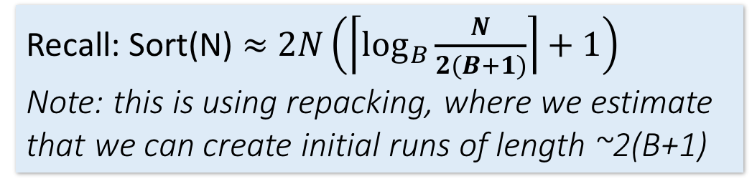
SMJ: Total cost
Lecture 15 > Section 1 > Backup
Cost of SMJ is cost of sorting R and S…
Plus the cost of scanning: ~P(R)+P(S)
Because of backup: in worst case P(R)*P(S); but this would be very unlikely
Plus the cost of writing out: ~P(R)+P(S) but in worst case T(R)*T(S)
~ Sort(P(R)) + Sort(P(S)) + P(R) + P(S) + OUT
Recall: Sort(N) $≈$ $2N\left(\left\lceil \log_{B}{\frac{N}{2(B+1)}}\right\rceil +1\right)$
Note: this is using repacking, where we estimate that we can create initial runs of length ~2(B+1)

Slide 49
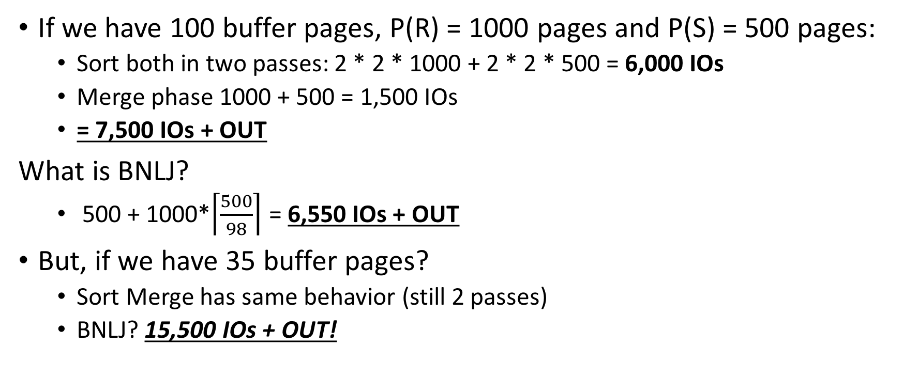
SMJ vs. BNLJ: Steel Cage Match
Lecture 15 > Section 1 > Backup
If we have 100 buffer pages, P(R) = 1000 pages and P(S) = 500 pages:
Sort both in two passes: 2 * 2 * 1000 + 2 * 2 * 500 = 6,000 IOs
Merge phase 1000 + 500 = 1,500 IOs
= 7,500 IOs + OUT
What is BNLJ?
500 + 1000*$\left\lceil \frac{500}{98}\right\rceil$ = 6,550 IOs + OUT
But, if we have 35 buffer pages?
Sort Merge has same behavior (still 2 passes)
BNLJ? 15,500 IOs + OUT!
SMJ is ~ linear vs. BNLJ is quadratic…
But it’s all about the memory.

Slide 50
A Simple Optimization: Merges Merged!
Lecture 15 > Section 1 > Backup
Given B+1 buffer pages
SMJ is composed of a sort phase and a merge phase
During the sort phase, run passes of external merge sort on R and S
Suppose at some point, R and S have <= B (sorted) runs in total
We could do two merges (for each of R & S) at this point, complete the sort phase, and start the merge phase…
OR, we could combine them: do one B-way merge and complete the join!

Slide 51
Un-Optimized SMJ
Lecture 15 > Section 1 > Backup
Given B+1 buffer pages
Unsorted input relations
Sort Phase
(Ext. Merge Sort)
R
S
Split & sort
Split & sort
Merge
Merge
Merge
Merge
Merge / Join Phase
Joined output file created!

Slide 52
Simple SMJ Optimization
Lecture 15 > Section 1 > Backup
Given B+1 buffer pages
Unsorted input relations
Sort Phase
(Ext. Merge Sort)
R
S
Split & sort
Split & sort
Merge
Merge
<= B total runs
B-Way Merge / Join
Merge / Join Phase
Joined output file created!

Slide 53
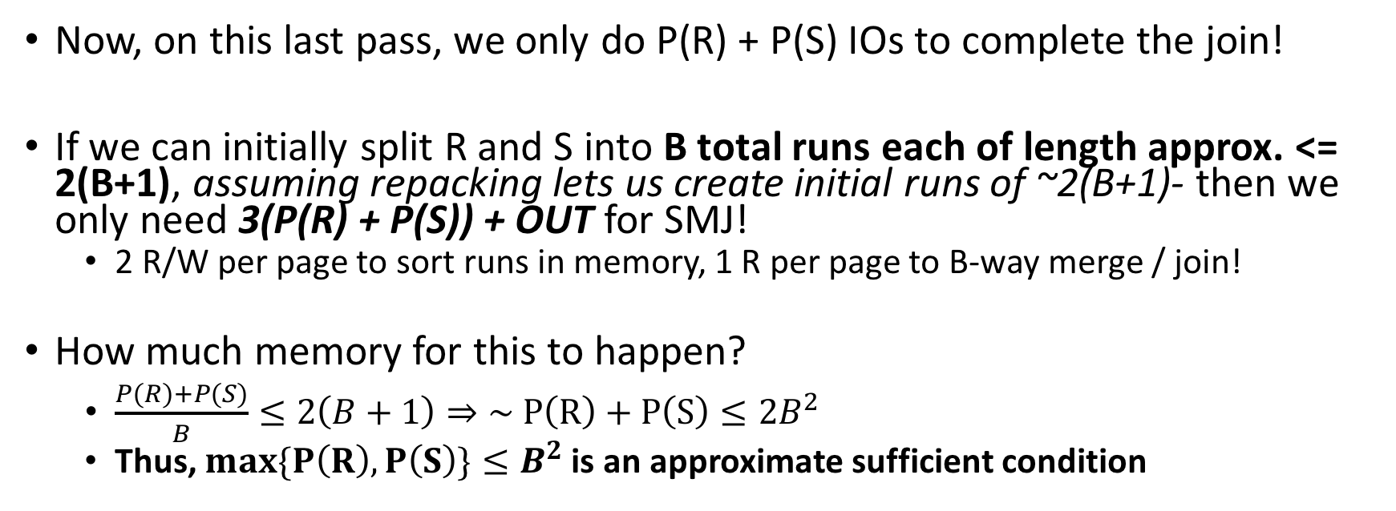
Simple SMJ Optimization
Lecture 15 > Section 1 > Backup
Given B+1 buffer pages
Now, on this last pass, we only do P(R) + P(S) IOs to complete the join!
If we can initially split R and S into B total runs each of length approx. <= 2(B+1), assuming repacking lets us create initial runs of ~2(B+1)- then we only need 3(P(R) + P(S)) + OUT for SMJ!
2 R/W per page to sort runs in memory, 1 R per page to B-way merge / join!
How much memory for this to happen?
$\frac{P\left(R\right)+P(S)}{B}≤2\left(B+1\right)⇒\sim P\left(R\right)+P\left(S\right)≤2B^{2}$
Thus, $max\{P\left(R\right), P\left(S\right)\}≤B^{2}$ is an approximate sufficient condition
If the larger of R,S has <= B² pages, then SMJ costs 3(P(R)+P(S)) + OUT!

Slide 54
Takeaway points from SMJ
Lecture 15 > Section 1 > Summary
If input already sorted on join key, skip the sorts.
SMJ is basically linear.
Nasty but unlikely case: Many duplicate join keys.
SMJ needs to sort both relations
If max { P(R), P(S) } < B² then cost is 3(P(R)+P(S)) + OUT

Slide 55

4. Hash Join (HJ)
Lecture 15 > Section 2

Slide 56
What you will learn about in this section
Lecture 15 > Section 2
Hash Join
Memory requirements

Slide 57
Recall: Hashing
Lecture 15 > Section 2 > HJ
Magic of hashing:
A hash function h_{B} maps into [0,B-1]
And maps nearly uniformly
A hash collision is when x != y but h_{B}(x) = h_{B}(y)
Note however that it will never occur that x = y but h_{B}(x) != h_{B}(y)
We hash on an attribute A, so our has function is h_{B}(t) has the form h_{B}(t.A).
Collisions may be more frequent.

Slide 58
Recall: Mad Hash Collisions
Lecture 15 > Section 2 > HJ
Say something here to justify this slide’s existence? [TODO]

Slide 59
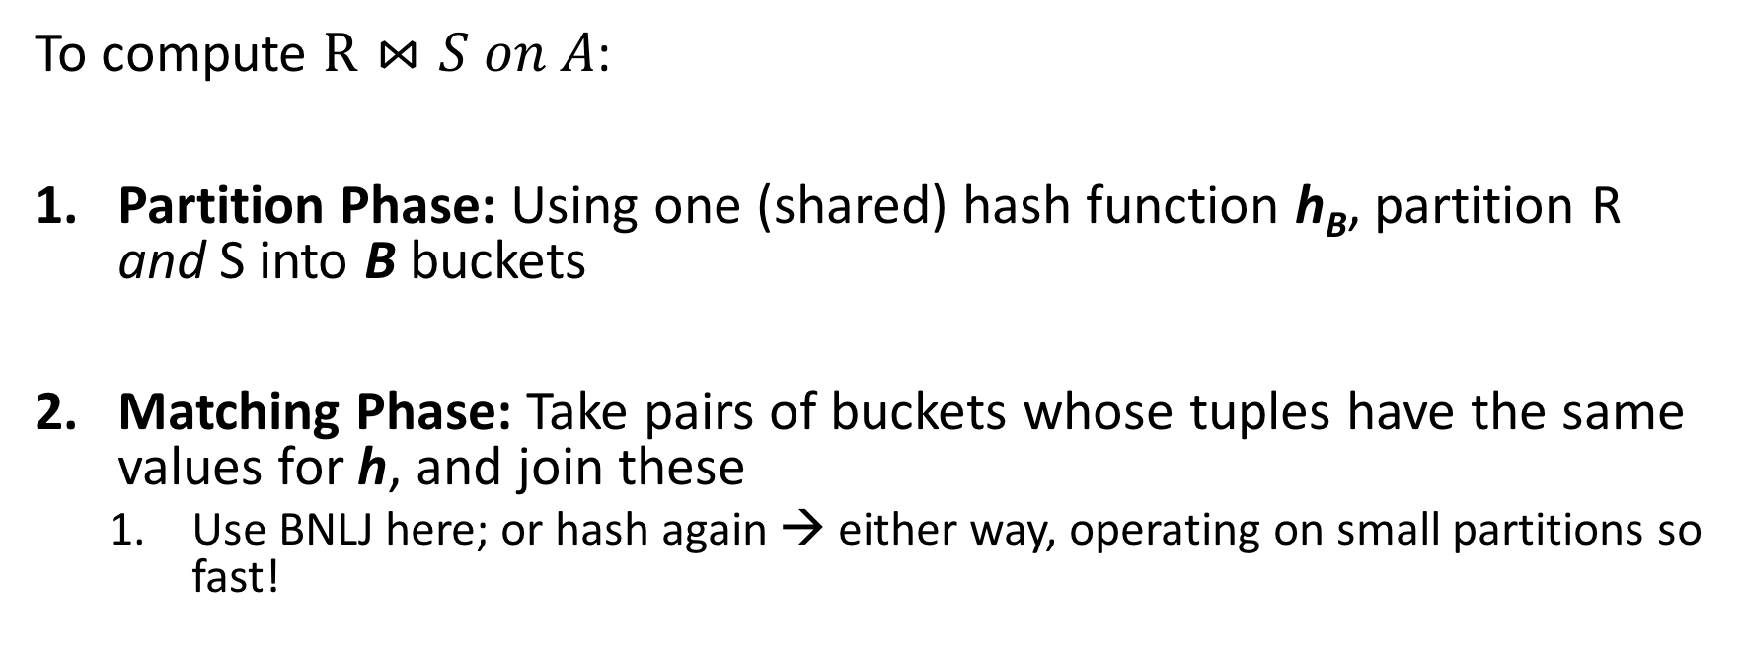
Hash Join: High-level procedure
Lecture 15 > Section 2 > HJ
Note again that we are only considering equality constraints here
To compute $R⋈S on A$:
Partition Phase: Using one (shared) hash function h_{B}, partition R and S into B buckets
Matching Phase: Take pairs of buckets whose tuples have the same values for h, and join these
Use BNLJ here; or hash again → either way, operating on small partitions so fast!
We decompose the problem using h_{B}, then complete the join

Slide 60
Hash Join: High-level procedure
Lecture 15 > Section 2 > HJ
1. Partition Phase: Using one (shared) hash function h_{B}, partition R and S into B buckets
Disk
Disk
Note our new convention: pages each have two tuples (one per row)
(0,a)
(0,a)
(0,j)
R
(0,a)
(0,a)
(3,j)
(0,j)
(3,b)
R₁
h_{B}
R₂
(3,j)
(3,b)
S
(0,a)
(0,j)
(5,b)
S₁
(0,a)
(0,j)
More detail in a second…
S₂
(5,b)
(5,b)

Slide 61
Hash Join: High-level procedure
Lecture 15 > Section 2 > HJ
2. Matching Phase: Take pairs of buckets whose tuples have the same values for h_{B}, and join these
Disk
Disk
(0,a)
(0,a)
(0,j)
R
(0,a)
(0,a)
(3,j)
(0,j)
(3,b)
R₁
h_{B}
Join matching buckets
R₂
(3,j)
(3,b)
S
(0,a)
(0,j)
(5,b)
S₁
(0,a)
(0,j)
S₂
(5,b)
(5,b)

Slide 62
Hash Join: High-level procedure
Lecture 15 > Section 2 > HJ
2. Matching Phase: Take pairs of buckets whose tuples have the same values for h_{B}, and join these
Disk
Disk
(0,a)
(0,a)
(0,j)
R
(0,a)
(0,a)
(3,j)
(0,j)
(3,b)
R₁
h_{B}
(3,j)
(3,b)
Don’t have to join the others! E.g. these!
R₂
S
(0,a)
(0,j)
(5,b)
S₁
(0,a)
(0,j)
S₂
(5,b)
(5,b)

Slide 63
Hash Join Phase 1: Partitioning
Lecture 15 > Section 2 > HJ
Goal: For each relation, partition relation into buckets such that if h_{B}(t.A) = h_{B}(t’.A) they are in the same bucket
Given B+1 buffer pages, we partition into B buckets:
We use B buffer pages for output (one for each bucket), and 1 for input
The “dual” of sorting.
For each tuple t in input, copy to buffer page for h_{B}(t.A)
When page fills up, flush to disk.

Slide 64
How big are the resulting buckets?
Lecture 15 > Section 2 > HJ
Given B+1 buffer pages
Given N input pages, we partition into B buckets:
→ Ideally our buckets are each of size ~ N/B pages
What happens if there are hash collisions?
Buckets could be > N/B
We’ll do several passes…
What happens if there are duplicate join keys?
Nothing we can do here… could have some skew in size of the buckets

Slide 65
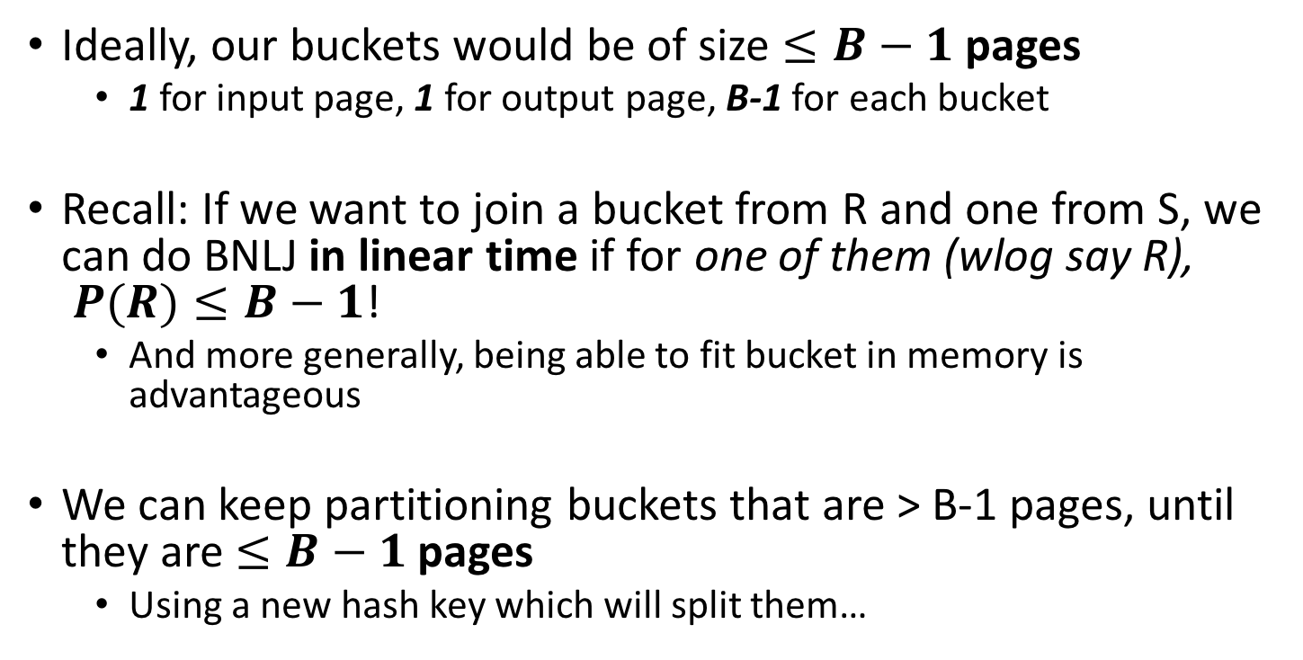
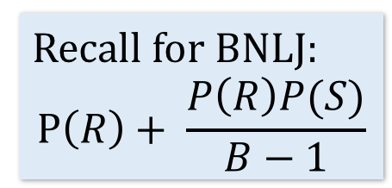
How big do we want the resulting buckets?
Lecture 15 > Section 2 > HJ
Given B+1 buffer pages
Ideally, our buckets would be of size $≤B−1$ pages
1 for input page, 1 for output page, B-1 for each bucket
Recall: If we want to join a bucket from R and one from S, we can do BNLJ in linear time if for one of them (wlog say R), $P(R)≤B−1$!
And more generally, being able to fit bucket in memory is advantageous
We can keep partitioning buckets that are > B-1 pages, until they are $≤B−1$ pages
Using a new hash key which will split them…
Recall for BNLJ:
$$P\left(R\right)+ \frac{P\left(R\right)P(S)}{B−1}$$
We’ll call each of these a “pass” again…

Slide 66
Hash Join Phase 1: Partitioning
Lecture 15 > Section 2 > HJ
Given B+1 = 3 buffer pages
We partition into B = 2 buckets using hash function h₂ so that we can have one buffer page for each partition (and one for input)
Disk
For simplicity, we’ll look at partitioning one of the two relations- we just do the same for the other relation!
(5,b)
(5,a)
(0,j)
(3,j)
(0,j)
R
(0,a)
(3,a)
Recall: our goal will be to get B = 2 buckets of size <= B-1 → 1 page each

Slide 67
Hash Join Phase 1: Partitioning
Lecture 15 > Section 2 > HJ
Given B+1 = 3 buffer pages
1. We read pages from R into the “input” page of the buffer…
Disk
Main Memory
(5,b)
(5,a)
(0,j)
(3,j)
(0,j)
R
Buffer
(0,a)
(3,a)
Input page
0
1
Output (bucket) pages

Slide 68
Hash Join Phase 1: Partitioning
Lecture 15 > Section 2 > HJ
Given B+1 = 3 buffer pages
2. Then we use hash function h₂ to sort into the buckets, which each have one page in the buffer
Disk
Main Memory
h₂(0) = 0
R
(5,b)
(5,a)
(0,j)
(3,j)
(0,j)
Buffer
(3,a)
(0,a)
(3,a)
(0,a)
Input page
0
1
Output (bucket) pages

Slide 69
Hash Join Phase 1: Partitioning
Lecture 15 > Section 2 > HJ
Given B+1 = 3 buffer pages
2. Then we use hash function h₂ to sort into the buckets, which each have one page in the buffer
Disk
Main Memory
h₂(3) = 1
R
(5,b)
(5,a)
(0,j)
(3,j)
(0,j)
Buffer
(3,a)
(0,a)
(3,a)
Input page
0
1
Output (bucket) pages

Slide 70
Hash Join Phase 1: Partitioning
Lecture 15 > Section 2 > HJ
Given B+1 = 3 buffer pages
3. We repeat until the buffer bucket pages are full…
Disk
Main Memory
R
(5,b)
(5,a)
(0,j)
(3,j)
(0,j)
Buffer
(0,a)
(3,a)
Input page
0
1
Output (bucket) pages

Slide 71
Hash Join Phase 1: Partitioning
Lecture 15 > Section 2 > HJ
Given B+1 = 3 buffer pages
3. We repeat until the buffer bucket pages are full…
Disk
Main Memory
h₂(3) = 1
R
(5,b)
(5,a)
(0,j)
Buffer
(3,j)
(0,j)
(3,a)
(3,j)
(0,j)
(0,a)
(3,a)
Input page
0
1
Output (bucket) pages

Slide 72
Hash Join Phase 1: Partitioning
Lecture 15 > Section 2 > HJ
Given B+1 = 3 buffer pages
3. We repeat until the buffer bucket pages are full…
Disk
Main Memory
h₂(0) = 0
R
(5,b)
(5,a)
(0,j)
Buffer
(0,a)
(0,j)
(3,a)
(3,j)
(0,j)
(0,a)
(3,a)
Input page
0
1
Output (bucket) pages

Slide 73
Hash Join Phase 1: Partitioning
Lecture 15 > Section 2 > HJ
Given B+1 = 3 buffer pages
3. We repeat until the buffer bucket pages are full… then flush to disk
Disk
Main Memory
R
(5,b)
(5,a)
(0,j)
Buffer
B0
(0,a)
(0,j)
(3,a)
(3,j)
B1
Input page
0
1
Output (bucket) pages

Slide 74
Hash Join Phase 1: Partitioning
Lecture 15 > Section 2 > HJ
Given B+1 = 3 buffer pages
3. We repeat until the buffer bucket pages are full… then flush to disk
Disk
Main Memory
R
(5,b)
(5,a)
(0,j)
Buffer
(0,a)
(0,j)
B0
(3,a)
(3,j)
Input page
B1
0
1
Output (bucket) pages

Slide 75
Hash Join Phase 1: Partitioning
Lecture 15 > Section 2 > HJ
Given B+1 = 3 buffer pages
Note that collisions can occur!
Collision!!!
Disk
Main Memory
h₂(5) = h₂(3) = 1
h₂(5) = 1
R
(5,b)
Buffer
(0,a)
(0,j)
(0,j)
(5,a)
B0
(5,a)
(0,j)
(3,a)
(3,j)
Input page
B1
0
1
Output (bucket) pages

Slide 76
Hash Join Phase 1: Partitioning
Lecture 15 > Section 2 > HJ
Given B+1 = 3 buffer pages
Finish this pass…
Disk
Main Memory
h₂(0) = 0
R
(5,b)
Buffer
(0,a)
(0,j)
(0,j)
(0,j)
(5,a)
B0
(3,a)
(3,j)
Input page
B1
0
1
Output (bucket) pages

Slide 77
Hash Join Phase 1: Partitioning
Lecture 15 > Section 2 > HJ
Given B+1 = 3 buffer pages
Finish this pass…
Disk
Main Memory
R
(5,b)
Buffer
(0,a)
(0,j)
(0,j)
(5,a)
B0
(3,a)
(3,j)
Input page
B1
0
1
Output (bucket) pages

Slide 78
Hash Join Phase 1: Partitioning
Lecture 15 > Section 2 > HJ
Given B+1 = 3 buffer pages
Finish this pass…
Collision!!!
Disk
Main Memory
h₂(5) = h₂(3) = 1
h₂(5) = 1
R
Buffer
(0,a)
(0,j)
(5,b)
(0,j)
(5,a)
B0
(5,a)
(5,b)
(3,a)
(3,j)
Input page
B1
0
1
Output (bucket) pages

Slide 79
Hash Join Phase 1: Partitioning
Lecture 15 > Section 2 > HJ
Given B+1 = 3 buffer pages
Finish this pass…
Disk
Main Memory
R
Buffer
(0,a)
(0,j)
(0,j)
(5,a)
(5,b)
B0
(3,a)
(3,j)
Input page
B1
0
1
Output (bucket) pages

Slide 80
Hash Join Phase 1: Partitioning
Lecture 15 > Section 2 > HJ
Given B+1 = 3 buffer pages
We wanted buckets of size B-1 = 1… however we got larger ones due to:
Disk
(0,a)
(0,j)
(0,j)
(1) Duplicate join keys
B0
(3,a)
(3,j)
(5,a)
(5,b)
(2) Hash collisions
B1

Slide 81
Hash Join Phase 1: Partitioning
Lecture 15 > Section 2 > HJ
Given B+1 = 3 buffer pages
To take care of larger buckets caused by (2) hash collisions, we can just do another pass!
Disk
(0,a)
(0,j)
(0,j)
What hash function should we use?
B0
(3,a)
(3,j)
(5,a)
(5,b)
B1
Do another pass with a different hash function, h’_{2,} ideally such that:
h’₂(3) != h’₂(5)

Slide 82
Hash Join Phase 1: Partitioning
Lecture 15 > Section 2 > HJ
Given B+1 = 3 buffer pages
To take care of larger buckets caused by (2) hash collisions, we can just do another pass!
Disk
(0,a)
(0,j)
(0,j)
What hash function should we use?
B0
(3,a)
(3,j)
B1
Do another pass with a different hash function, h’_{2,} ideally such that:
h’₂(3) != h’₂(5)
(5,a)
(5,b)
B2

Slide 83
Hash Join Phase 1: Partitioning
Lecture 15 > Section 2 > HJ
Given B+1 = 3 buffer pages
What about duplicate join keys? Unfortunately this is a problem… but usually not a huge one.
Disk
(0,a)
(0,j)
(0,j)
B0
We call this unevenness in the bucket size skew
(3,a)
(3,j)
B1
(5,a)
(5,b)
B2

Slide 84
Now that we have partitioned R and S…
Lecture 15 > Section 2 > HJ

Slide 85
Hash Join Phase 2: Matching
Lecture 15 > Section 2 > HJ
Now, we just join pairs of buckets from R and S that have the same hash value to complete the join!
Disk
Disk
(0,a)
(0,a)
(0,j)
R
(0,a)
(0,a)
(3,j)
(0,j)
(3,b)
R₁
h_{B}
Join matching buckets
R₂
(3,j)
(3,b)
S
(0,a)
(0,j)
(5,b)
S₁
(0,a)
(0,j)
S₂
(5,b)
(5,b)

Slide 86
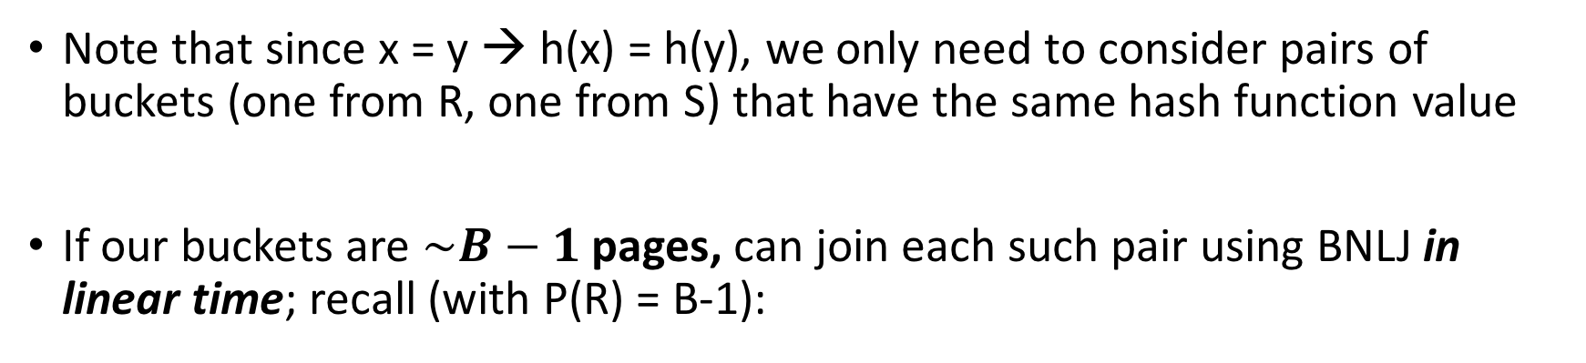
Hash Join Phase 2: Matching
Lecture 15 > Section 2 > HJ
Note that since x = y → h(x) = h(y), we only need to consider pairs of buckets (one from R, one from S) that have the same hash function value
If our buckets are $\sim B−1$ pages, can join each such pair using BNLJ in linear time; recall (with P(R) = B-1):
BNLJ Cost: $P\left(R\right)+ \frac{P\left(R\right)P(S)}{B−1}=P(R)+ \frac{(B−1)P(S)}{B−1}$ = P(R) + P(S)
Joining the pairs of buckets is linear!
(As long as smaller bucket <= B-1 pages)

Slide 87
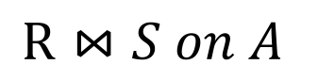
Hash Join Phase 2: Matching
Lecture 15 > Section 2 > HJ
h(1)=0
h(1)=0
h(2)=0
h(3)=1
h(3)=1
h(4)=1
h(5)=2
h(6)=2
h(6)=2
 | h(1) | h(1) | h(2) | h(2) | h(3) | h(4) | h(5) | h(6) | h(6)
$$R⋈S on A$$
R.A hashed values
S.A hashed values

Slide 88
Hash Join Phase 2: Matching
Lecture 15 > Section 2 > HJ
A=1
$$R⋈S on A$$
h(1)=0
h(1)=0
h(2)=0
h(3)=1
h(3)=1
h(4)=1
h(5)=2
h(6)=2
h(6)=2
 | h(1) | h(1) | h(2) | h(2) | h(3) | h(4) | h(5) | h(6) | h(6)
A=2
To perform the join, we ideally just need to explore the dark blue regions
= the tuples with same values of the join key A
A=3
R.A hashed values
A=4
A=5
A=6
S.A hashed values

Slide 89
Hash Join Phase 2: Matching
Lecture 15 > Section 2 > HJ
h(1)=0
h(1)=0
h(2)=0
h(3)=1
h(3)=1
h(4)=1
h(5)=2
h(6)=2
h(6)=2
 | h(1) | h(1) | h(2) | h(2) | h(3) | h(4) | h(5) | h(6) | h(6)
$$R⋈S on A$$
With a join algorithm like BNLJ that doesn’t take advantage of equijoin structure, we’d have to explore this whole grid!
R.A hashed values
S.A hashed values

Slide 90
Hash Join Phase 2: Matching
Lecture 15 > Section 2 > HJ
h(A)=0
$$R⋈S on A$$
h(1)=0
h(1)=0
h(2)=0
h(3)=1
h(3)=1
h(4)=1
h(5)=2
h(6)=2
h(6)=2
 | h(1) | h(1) | h(2) | h(2) | h(3) | h(4) | h(5) | h(6) | h(6)
With HJ, we only explore the blue regions
= the tuples with same values of h(A)!
h(A)=1
R.A hashed values
h(A)=2
S.A hashed values
We can apply BNLJ to each of these regions

Slide 91
Hash Join Phase 2: Matching
Lecture 15 > Section 2 > HJ
h'(A)=0
$$R⋈S on A$$
h'(A)=1
An alternative to applying BNLJ:
We could also hash again, and keep doing passes in memory to reduce further!
h'(A)=2
R.A hashed values
h'(A)=3
h'(A)=4
h'(A)=5
S.A hashed values

Slide 92
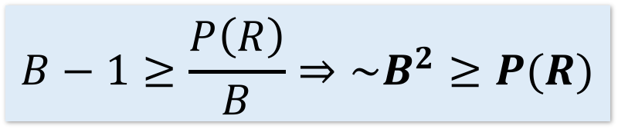
How much memory do we need for HJ?
Lecture 15 > Section 2 > Memory requirements
Given B+1 buffer pages
Suppose (reasonably) that we can partition into B buckets in 2 passes:
For R, we get B buckets of size ~P(R)/B
To join these buckets in linear time, we need these buckets to fit in B-1 pages, so we have:
+ WLOG: Assume P(R) <= P(S)
$$B−1≥\frac{P\left(R\right)}{B}⇒\sim B^{2}≥P(R)$$
Quadratic relationship between smaller relation’s size & memory!

Slide 93
Hash Join Summary
Lecture 15 > Section 2 > Memory requirements
Given enough buffer pages as on previous slide…
Partitioning requires reading + writing each page of R,S
→ 2(P(R)+P(S)) IOs
Matching (with BNLJ) requires reading each page of R,S
→ P(R) + P(S) IOs
Writing out results could be as bad as P(R)*P(S)… but probably closer to P(R)+P(S)
HJ takes ~3(P(R)+P(S)) + OUT IOs!

Slide 94
3. The Cage Match
Lecture 15 > Section 3 > The Cage Match

Slide 95
Sort-Merge v. Hash Join
Lecture 15 > Section 3 > The Cage Match
Given enough memory, both SMJ and HJ have performance:
“Enough” memory =
SMJ: B² > max{P(R), P(S)}
HJ: B² > min{P(R), P(S)}
~3(P(R)+P(S)) + OUT
Hash Join superior if relation sizes differ greatly. Why?
Notes:
16

Slide 96
Further Comparisons of Hash and Sort Joins
Lecture 15 > Section 3 > The Cage Match
Hash Joins are highly parallelizable.
Sort-Merge less sensitive to data skew and result is sorted

Slide 97
Summary
Lecture 15 > Section 3 > The Cage Match
Saw IO-aware join algorithms
Massive difference
Memory sizes key in hash versus sort join
Hash Join = Little dog (depends on smaller relation)
Skew is also a major factor

